Slide 1
Pupil Health and Lifestyle Survey.
Secondary School Presentation

Slide 2
What is it all about?
Let’s Hear Your Voice is a health and lifestyle survey
We want pupils in year 4, 6, 8, 10 and post 16 to take part.
The survey will ask you different questions about your health and lifestyle
Barnsley Council would like the survey to be answered every two years so you will probably see this survey again in the future!

Slide 3
Why is it so important?
We want to better understand the young people of Barnsley
We would like to use the information we collect with your school and wide young people's services to ensure we are supporting you to live your best life!
By answering the questions, it will give you a chance for your voice to be heard about the things that matter to you.
The survey will help us to understand any issues in Barnsley and we can then work hard to address them.

Slide 4
What will Let’s Hear Your Voice ask me?
The survey will ask you questions on different topics such as physical activity, relationships, hobbies, feelings.
It is not a test there are no right or wrong answers.
Please ask for help if you get stuck.
Please answer honestly.

Slide 5
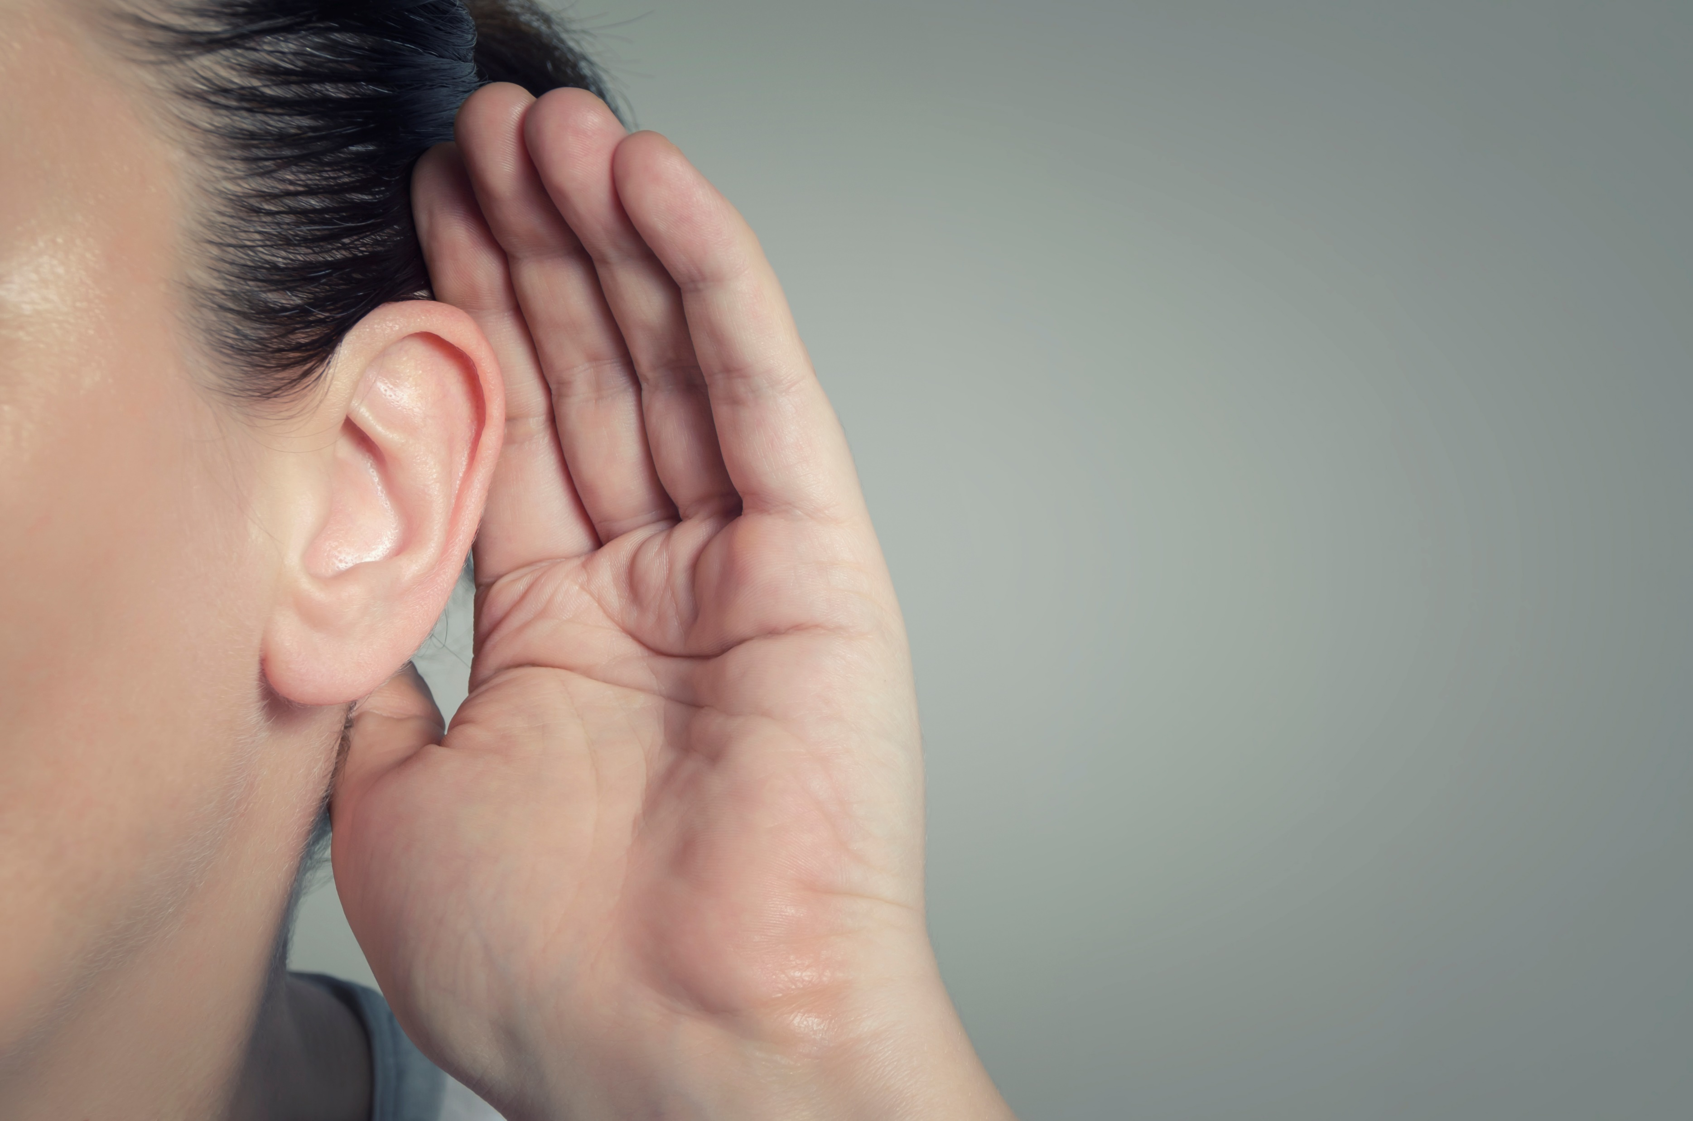
Personal questions
Some of the questions are on topics which might feel quite personal or triggering.
There are some questions about drugs, alcohol, smoking and sexual activity.
No one will know your answers – all the responses are completely anonymous.
If you don’t feel comfortable answering a question you can move to the next question

Slide 6
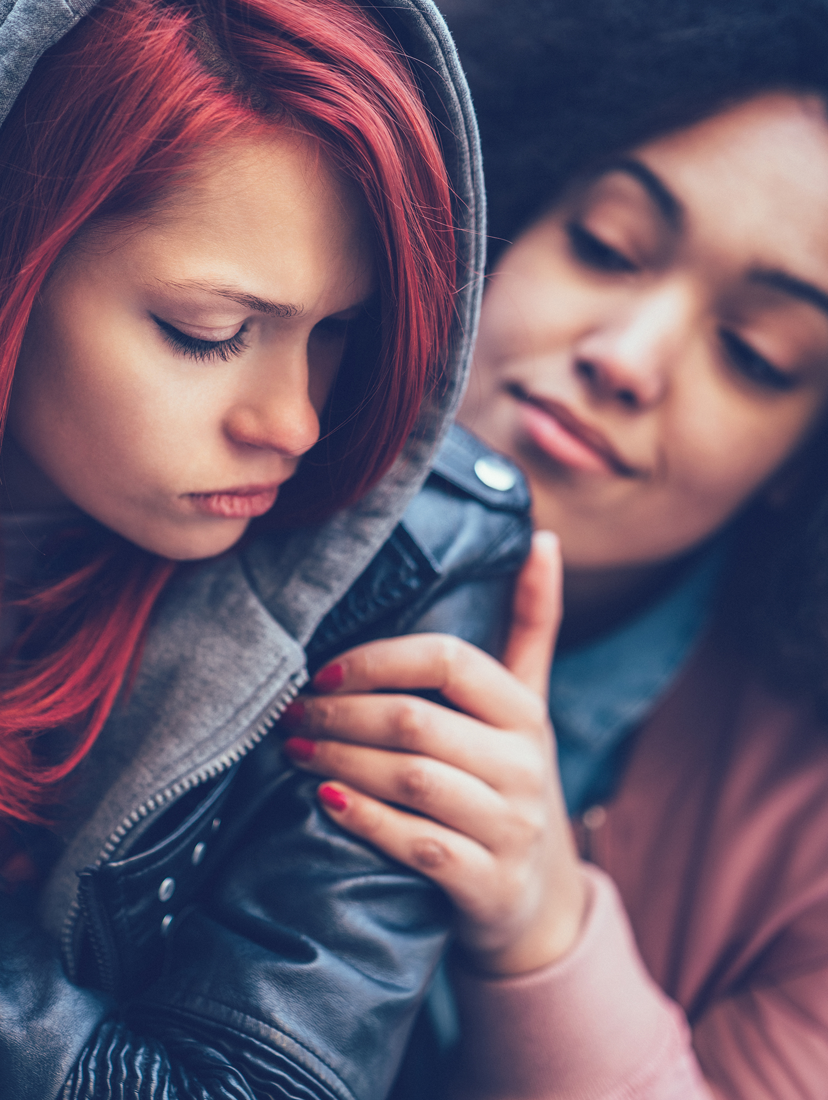
Triggering questions
Some of the questions may trigger emotions or may make you think about seeking help or support.
There are links to support services on some of the questions we have deemed as potentially triggering
You can also speak to your school pastoral lead for some support if you need it.

Slide 7
What does it look like?
There are two styles of question:
A multiple-choice question (where you select one or more answers)
A sliding scale question
Some questions allow you to write your own responses. These questions have ‘other’ boxes on them

Slide 8
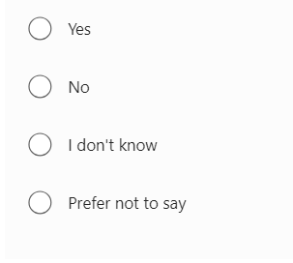
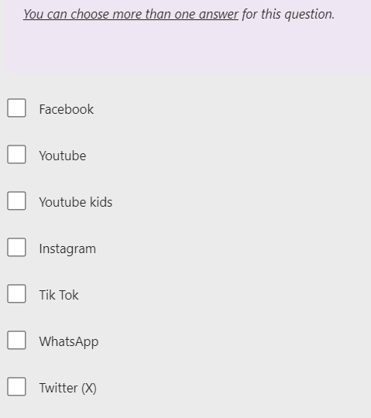
Different styles of multiple-choice questions
Some questions might let you tick more than one answer
others might just want one.
There are also some questions which have a text box allowing you to write your own responses in the box

Slide 9
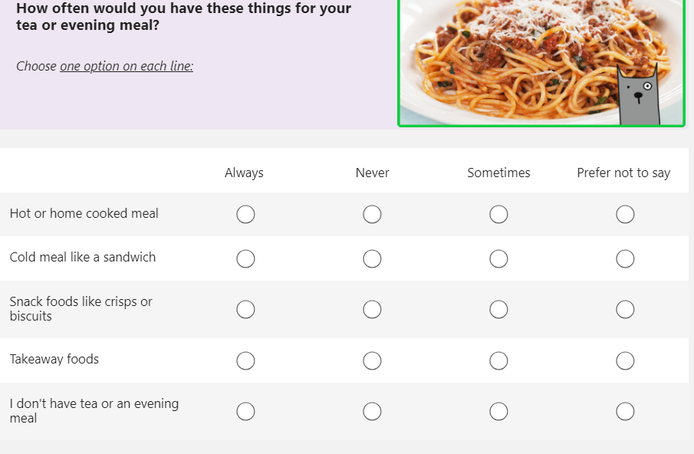
Different styles of multiple-choice questions
Some questions might look like this, with lots of options
All you need to do is tick one box on each line.

Slide 10
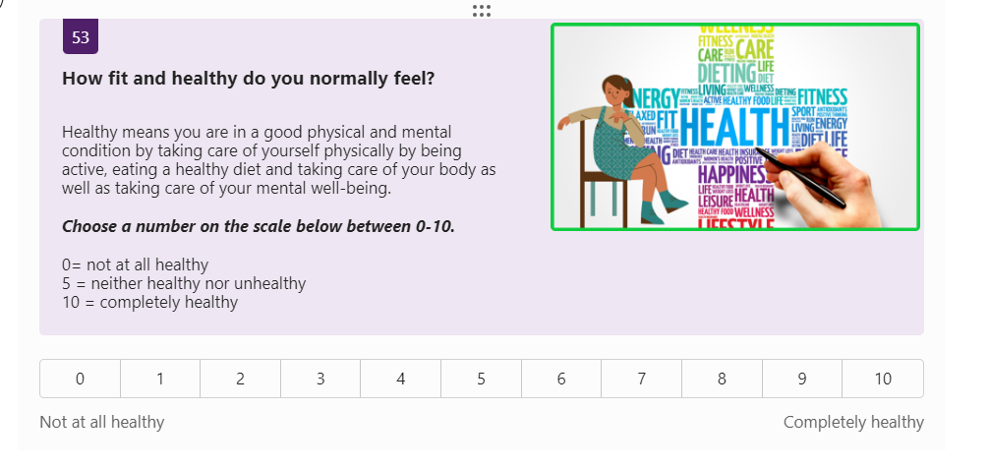
Sliding scale questions
This is the question.
These questions have a key of options. In this example:
0=not at all healthy and 10= completely healthy
This is the slider – click on the number that is most relevant to you.

Slide 11
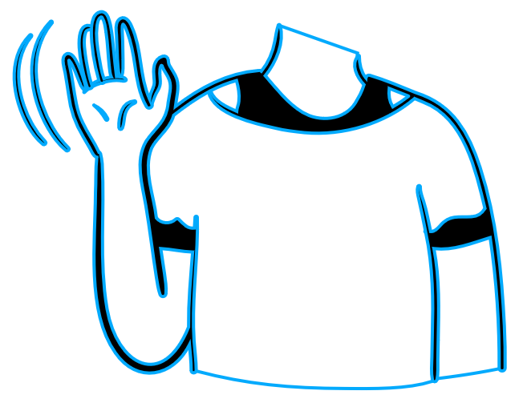
How do I take part?
Let’s Hear Your Voice questions are all completed on a computer or
tablet.
You can skip any question that you do not understand or do not want to answer.
Don’t forget to ask for help if you need it
If you prefer to hear the question instead of read it, each question has a recorded version. Just press the play button on each question.
You do not have to take part if you don't want to - just speak to your teacher about it.

Slide 12
Will anyone see my answers?
Let’s Hear Your Voice is completely anonymous
Please answer as honestly as you can. There are no right or wrong answers.
The council will keep your answers safe on their computers.

Slide 13
How can I get help after I have taken part?
If you finish the survey and want to speak to someone you can speak to the appropriate staff member in your school – this might be a pastoral lead, teacher or head of year, whoever you feel most comfortable speaking with.
The 0-19 Public Health Nursing Service can also help and support you with your physical and emotional wellbeing. You can contact the school nursing team by.
In person- at your school nurse health drop in session
Single Point of Access -call (01226) 774411
Facebook Instant Messenger- if over 13 search Barnsley 0-19 Public Health Nursing Service

Slide 14
Thank you for your support and participation

