Slide 1
Primary School Presentation

Slide 2
What is Let’s Hear Your Voice all about?
Let’s Hear Your Voice is a health and lifestyle survey.
Let’s Hear Your Voice will be completed by pupils in year 4, 6, 8, 10 and post 16 across Barnsley.
The survey will ask you different questions about your health, things in your life, your school day, your safety and how you feel.
This survey will go out every two years so you will probably see it again in the future!

Slide 3
Why is it so important?
We want to understand what is going on in the lives of children and young people so that we can do our best to help you live happy healthy lives.
Your school and other organisations can use the information from the survey to help support you in the best way they can.
By answering the questions it will give you a chance for your voice to be heard about the things that matter to you.
The survey will help us to understand any issues in Barnsley and we can then work hard to address them.

Slide 4
What will Let’s Hear Your Voice ask me?
The survey will ask you questions on different topics such as physical activity, hobbies, feelings, food drink and oral health among others…
It is not a test there are no right or wrong answers.
Please ask for help if you get stuck.
Please answer honestly.

Slide 5
What does it look like?
There are two styles of question:
A multiple-choice question (where you select one or more answers), and
A sliding scale question.
There are also ‘other’ boxes on some questions which you can write your own answer in the box

Slide 6
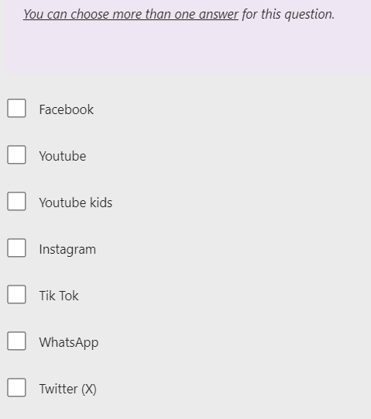
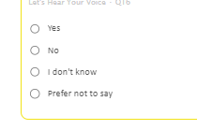
Here are some examples:
Some questions might let you select more than one answer:
Others might just want one:

Slide 7
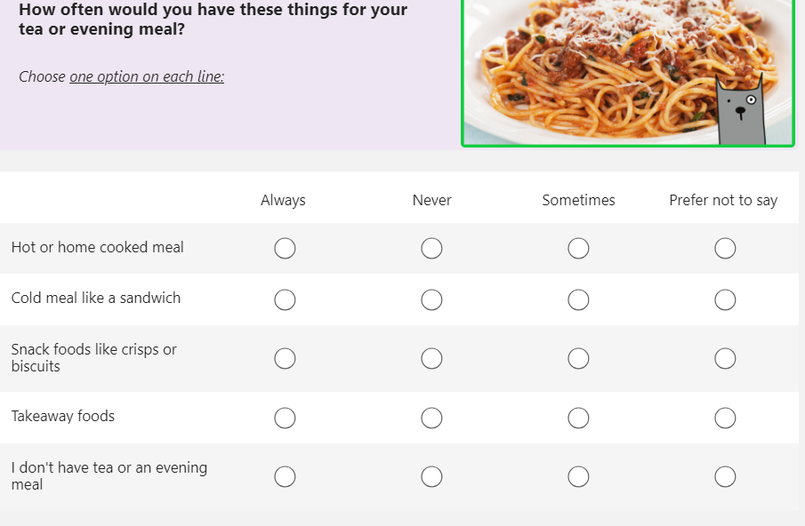
Example:
Some questions might look like this, with lots of options
All you need to do is tick one box on each line.

Slide 8
How do I take part?
Let’s Hear Your Voice questions are all completed on a computer or
tablet.
You can skip any question that you do not understand or do not want to answer.
Don’t forget to ask for help if you need it
if you prefer to hear the question instead of read it each question has recorded version. Just press the play button at the side of each question
You do not have to take part if you don't want to - just speak to your teacher about it.

Slide 9
Will anyone see my answers?
Let’s Hear Your Voice is completely anonymous
Please answer as honestly as you can. There are no right or wrong answers.
The council will keep your answers safe on their computers.

Slide 10
How can I get help after I have taken part?
If you finish the survey and want to speak to someone – you can speak with a teacher or other staff member that you feel comfortable talking to.

Slide 11
Thank you, for listening

